Slide 1

SHOULD WE MOVE TO WHICH PART OF TORONTO?
A report on neighborhoods

Slide 2
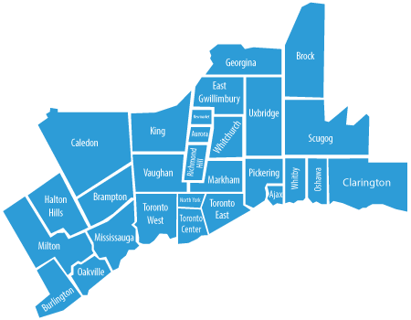
objective
Collecting Neighborhood’s top trending venues
Forming neighborhood clusters based on venue categories
Giving a better decision of choosing which neighborhood wins over other.

Slide 3
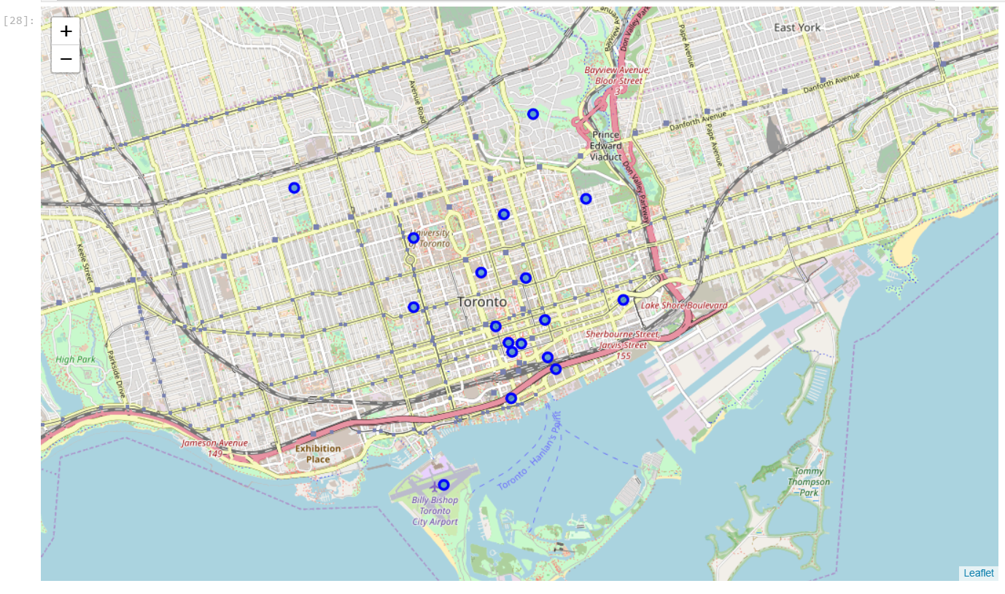
Neighborhood distribution

Slide 4
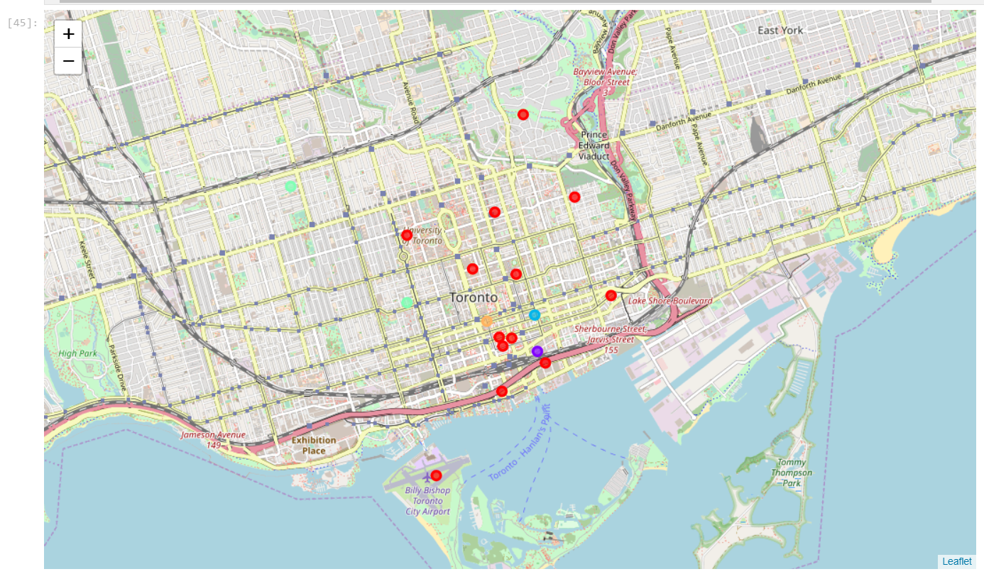
Neighborhood clusters

Slide 5
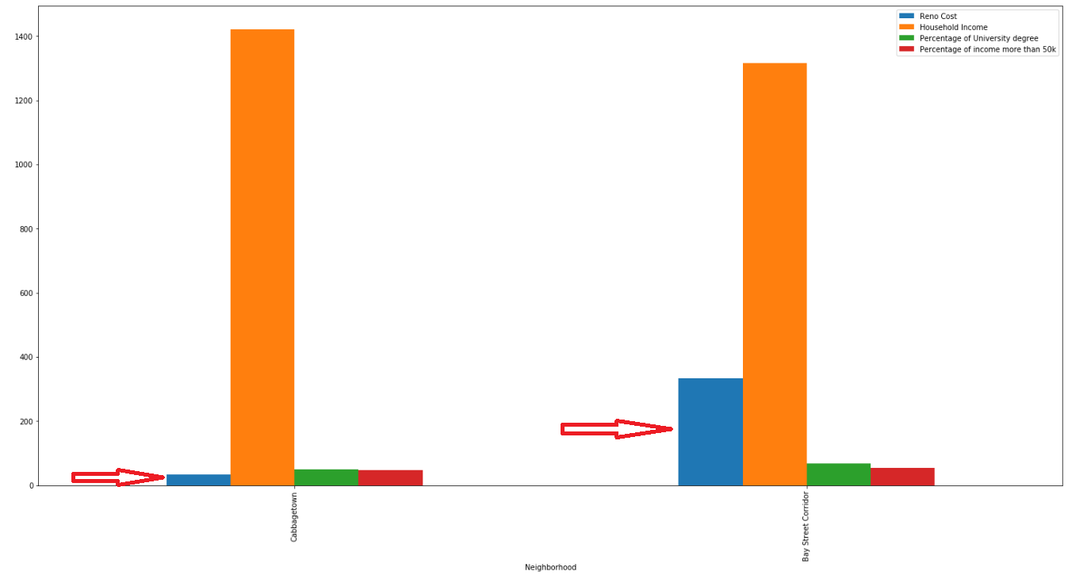
Chart of comparision

Slide 6
conclusion
This analysis concludes that Cabbagetown has the significant lower renovation cost and higher average income than Bay Street Corridor. Despite the percentage of people who has bachelor degree in Bay Street is slightly higher than Cabbagetown, as well as the percentage of population that belongs to the middle-class is higher too; living in Cabbagetown is definitely more than reasonable!
Hence, Cabbagetown wins over Bay Street Corridor!!!

Slide 7


